Slide 1
SS G515 - Data Warehousing: Dimensional Modeling
Dr. Yashvardhan Sharma
Assistant Professor, CS & IS Dept.
BITS-Pilani

Slide 2
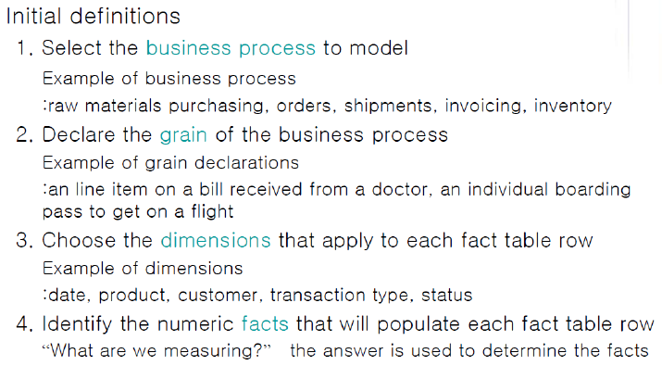
Four -Step Dimensional Design Process

Slide 3
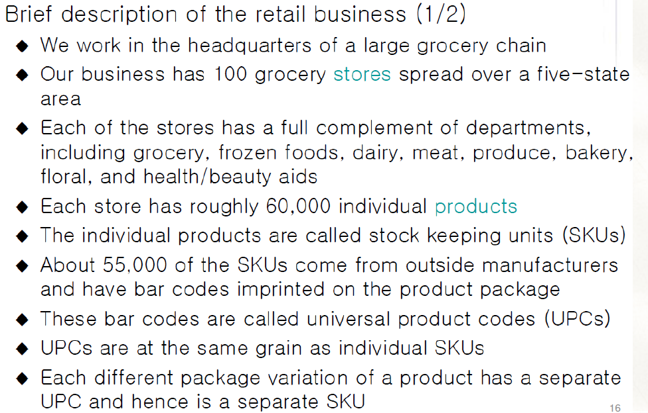
Retail Case Study

Slide 4
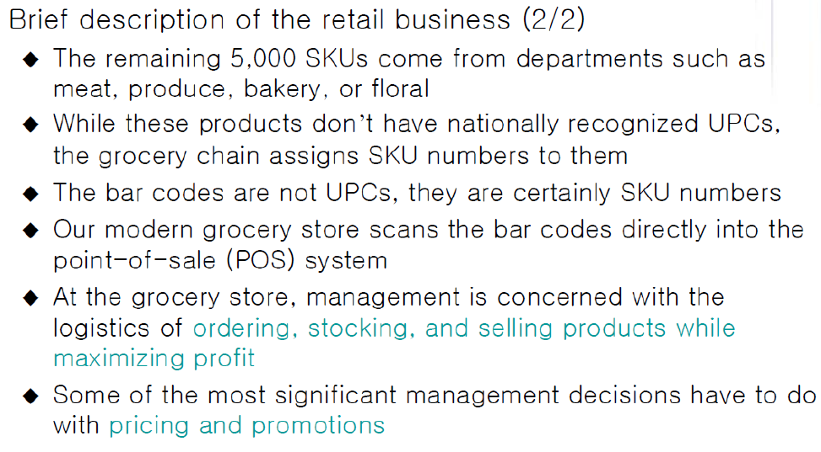
Retail Case Study

Slide 5
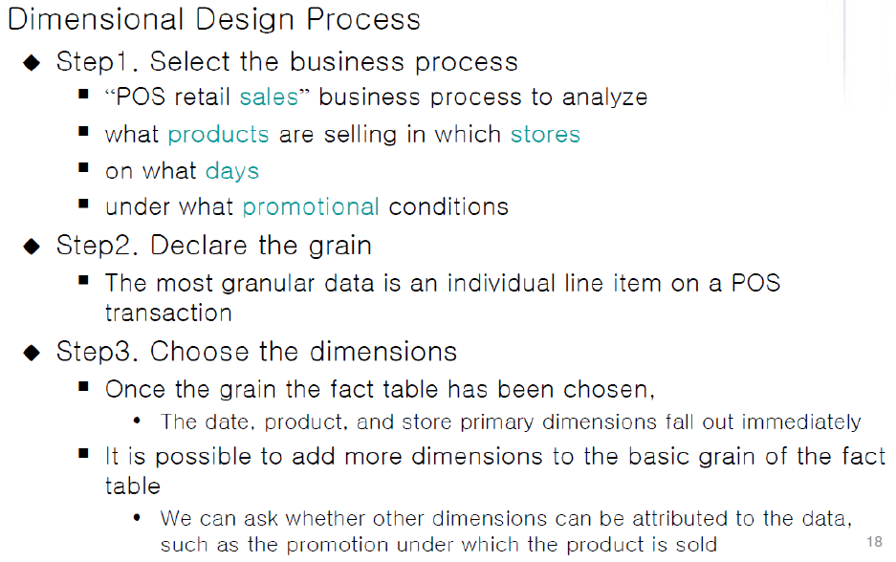
Retail Case Study

Slide 6
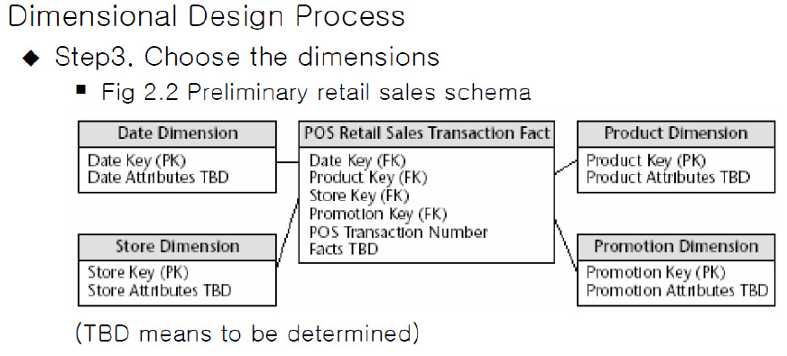
Retail Case Study

Slide 7
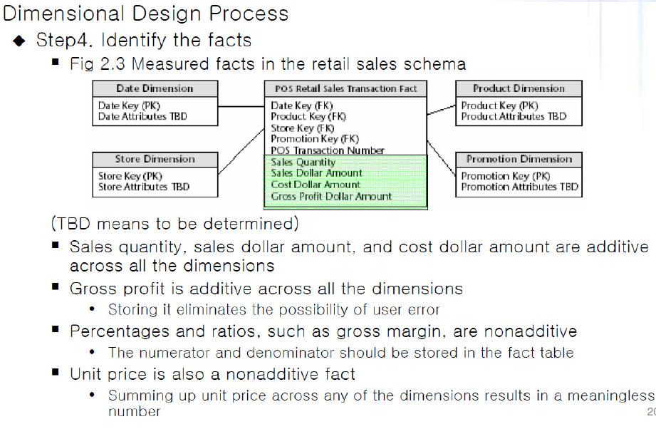
Retail Case Study

Slide 8
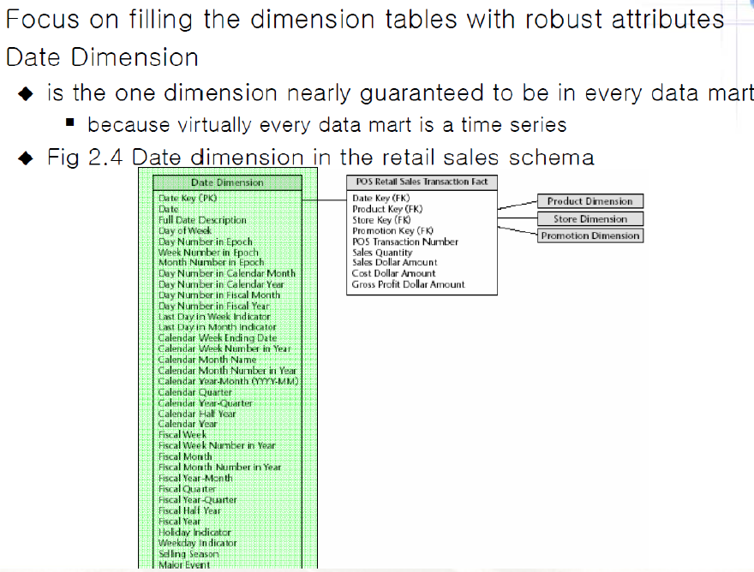
Dimensional Table Attributes

Slide 9
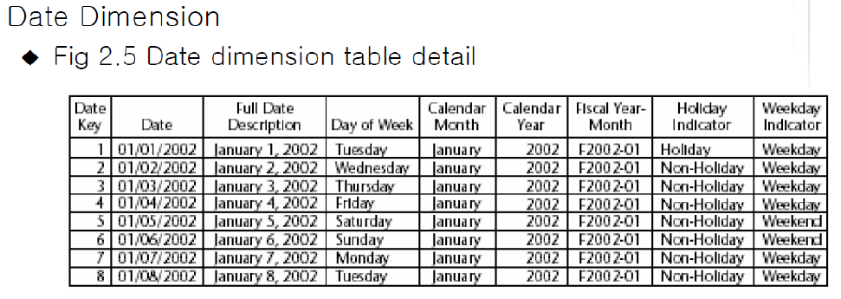
Dimensional Table Attributes

Slide 10
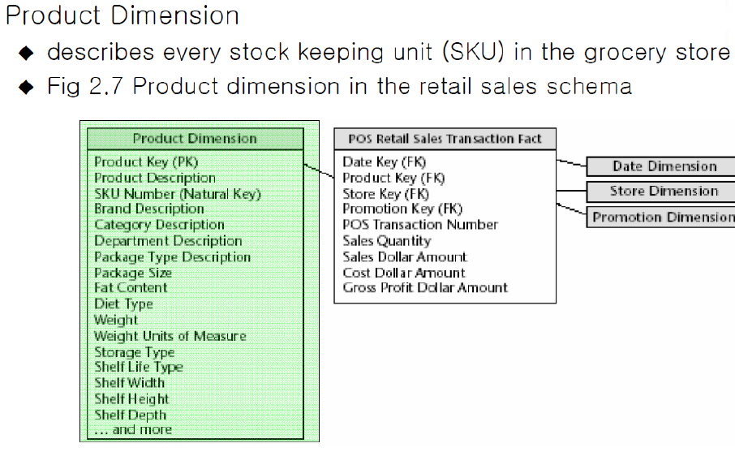
Dimensional Table Attributes

Slide 11
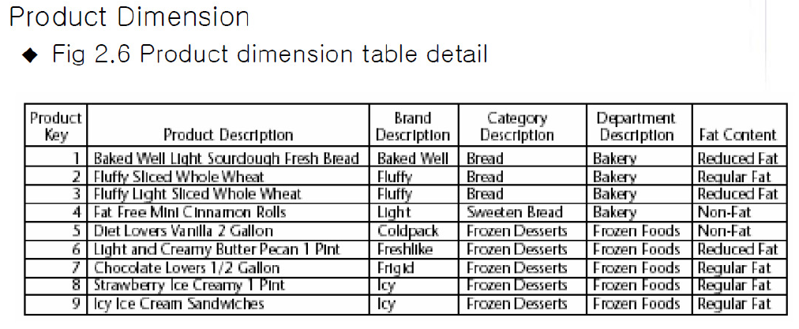
Dimensional Table Attributes

Slide 12
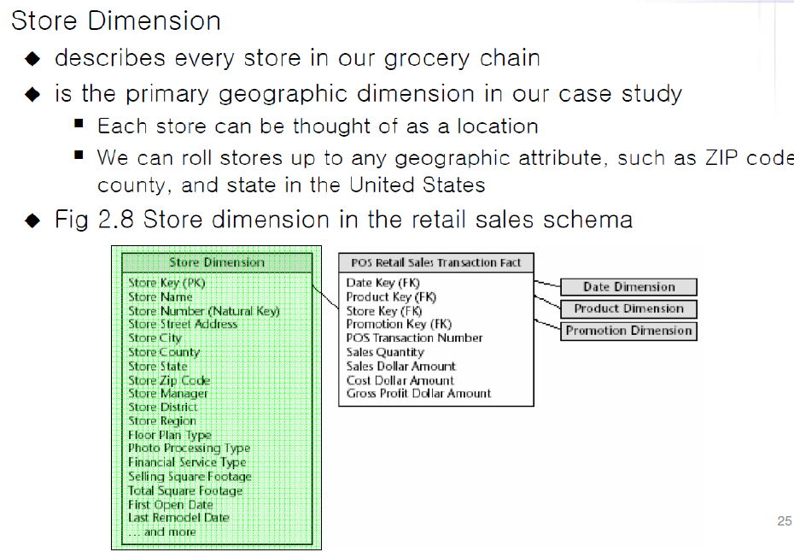
Dimensional Table Attributes

Slide 13
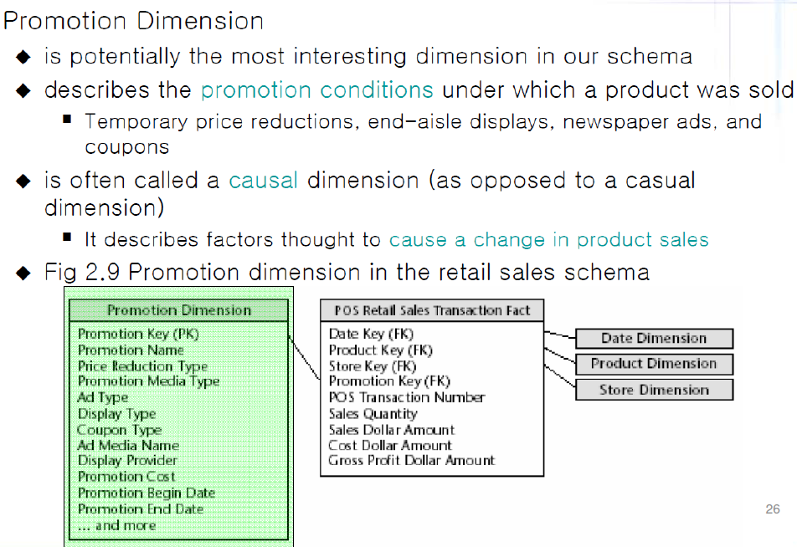
Dimensional Table Attributes

Slide 14
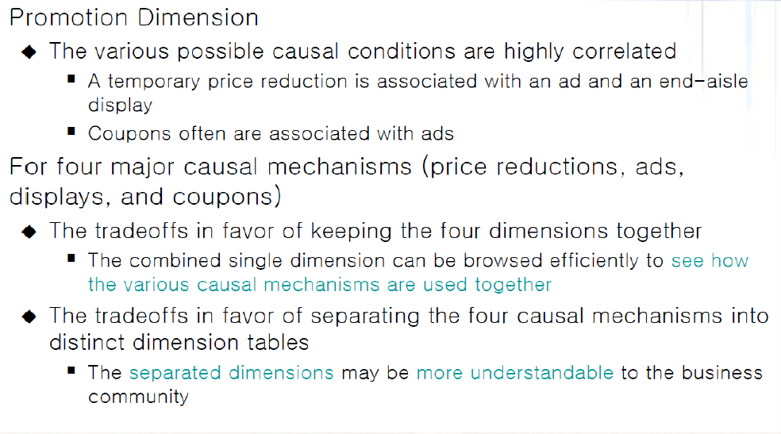
Dimensional Table Attributes

Slide 15
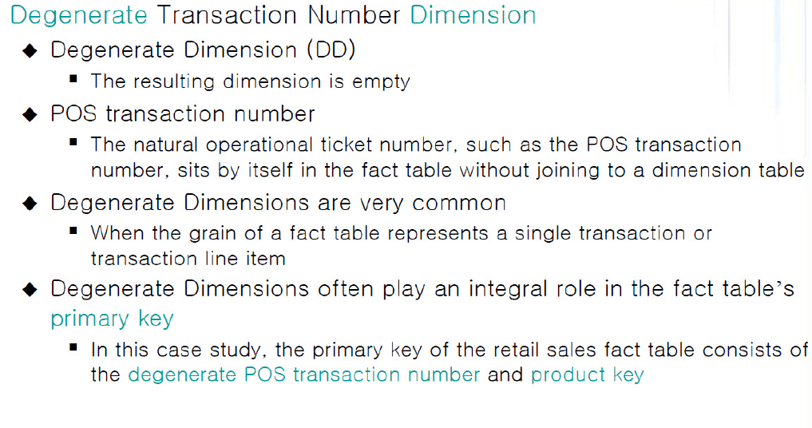
Dimensional Table Attributes

Slide 16
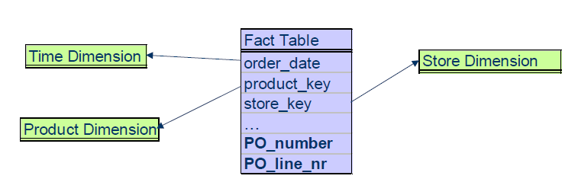
Degenerate Dimension
A degenerate dimension is represented by a dimension key attribute(s) with no corresponding dimension table
• Occurs usually in line-item oriented fact table design

Slide 17
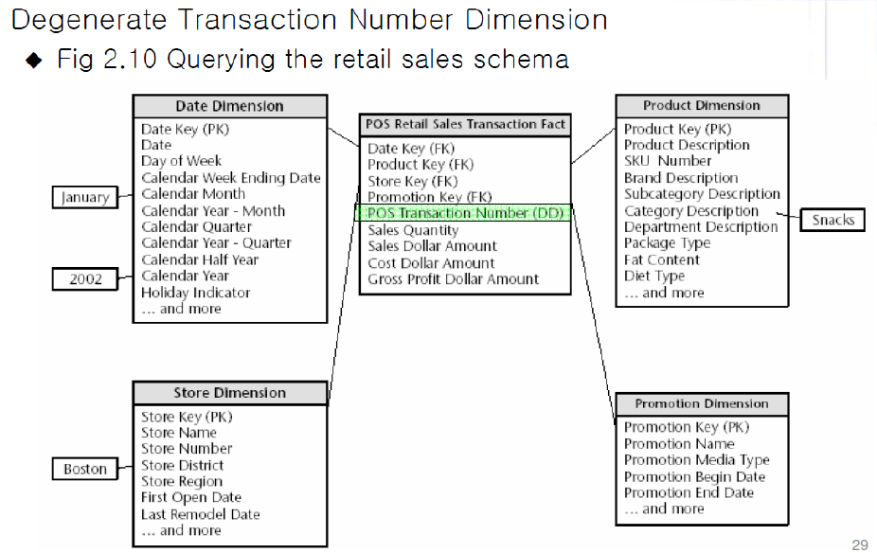
Dimensional Table Attributes

Slide 18
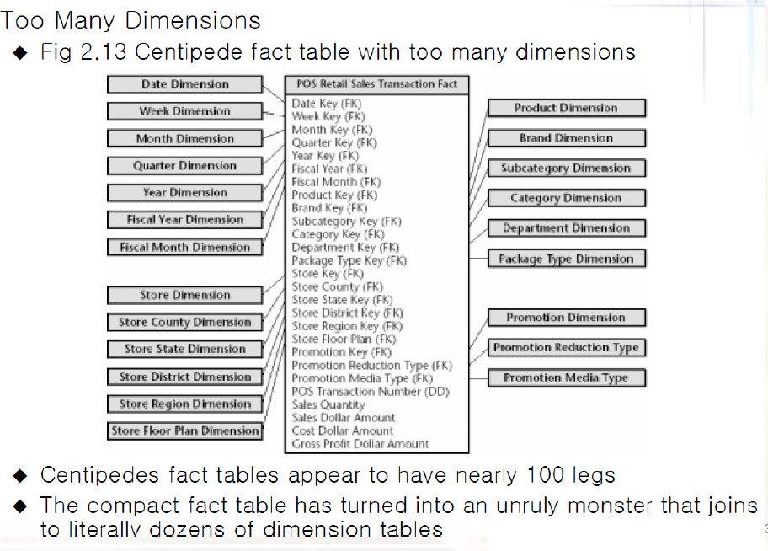
Denormalized Fact Tables

Slide 19
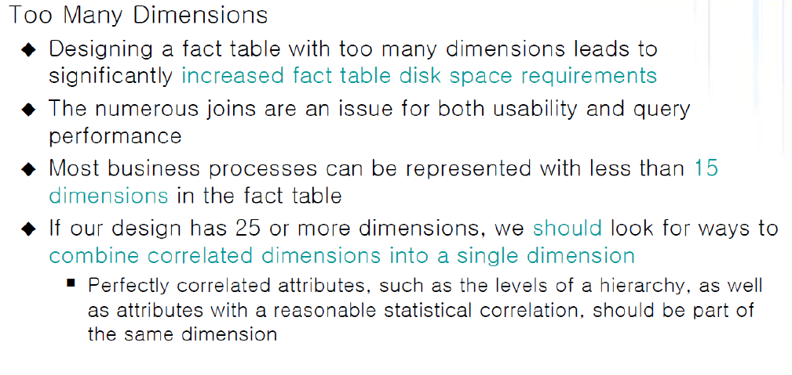
Denormalized Fact Tables

Slide 20
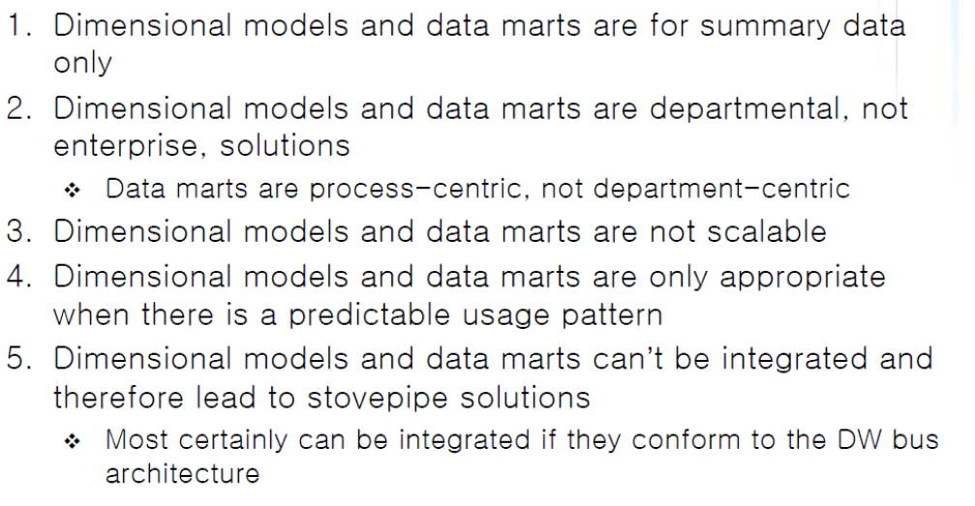
Dimensional Modeling Myths

